Slide 1
Smart energy mointering system an iot based random electricity consumption monitering system
PROJECT BY :

Slide 2
AIM: The goal of this project is to visualize and monitor the power consumption online on a smart phone using mobile application by integrating smart plugs, sensors, Internet of Things (IOT) devices.

Slide 3
Abstract
Lack of resources established in the present world is initiating everyone towards energy efficient technologies. Among all these resources, power is one which needs to be monitored and controlled as per the need since electricity consumption is increasing day-by day.
Power is the soul of world which is related to the electricity and “electricity” is the word which now rules the world. So, proper utilization of these resources is of immense important to us. Though many technological innovations are taking place in this world, existing electricity consumption billing process seems in India to be very old fashioned and does not meet the latest technology available.

Slide 4
Continue..
Thereby, facilitating the user to act accordingly to save power or to provide the reliable power supply by making maximum use of Renewable Energy Sources.

Slide 5
BLOCK DIAGRAM
Power Supply
Energy Meter
Micro Controller
LCD
IOT
Relay
Switch
Buzzer
Load

Slide 6
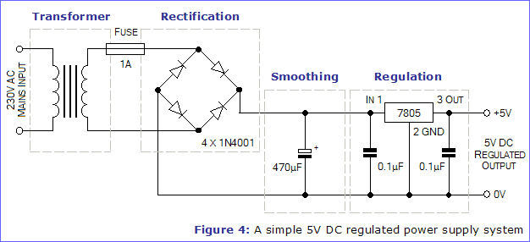
POWER SUPPLY
Converting the available AC supply to dc
Using rectifier for conversion of AC to DC
Regulator To Provide Regulated power supply.

Slide 7
MICROCONTROLLER
A Microcontroller (or MCU) is a computer-on-a-chip used to control electronic device. It is a type of microprocessor emphasizing self-sufficiency and cost-effectiveness, in contrast to a general-purpose microprocessor (the kind used in a PC). A typical microcontroller contains all the memory and interfaces needed for a simple application.

Slide 8
ARDUINO NANO MICROCONTOLLER ATMEGA 328
Arduino/Genuino Uno is a microcontroller board based on the ATmega328P. It has 14 digital input/output pins (of which 6 can be used as PWM outputs), 6 analog inputs, a 16 MHz quartz crystal, a USB connection, a power jack, an ICSP header and a reset button. It contains everything needed to support the microcontroller; simply connect it to a computer with a USB cable or power it with a AC-to-DC adapter or battery to get started.. You can tinker with your UNO without worring too much about doing something wrong, worst case scenario you can replace the chip for a few dollars and start over again.

Slide 9
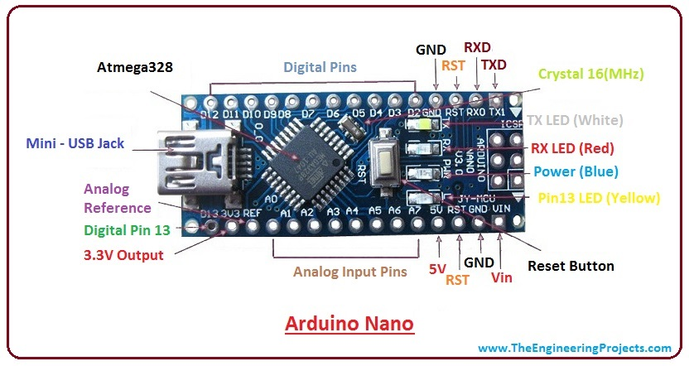
ARDUINO NANO BOARD

Slide 10
FEATURES
Microcontroller: ATmega328
Operating Voltage: 5V
Input Voltage (recommended): 7-12V
Input Voltage (limits): 6-20V
Digital I/O Pins: 14 (of which 6 provide PWM output)
Analog Input Pins: 6
DC Current per I/O Pin: 40 mA
DC Current for 3.3V Pin: 50 mA
Flash Memory: 32 KB of which 0.5 KB used by bootloader
SRAM: 2 KB (ATmega328)
EEPROM: 1 KB (ATmega328)
Clock Speed: 16 MHz

Slide 11
ESP8266(wifi Module)
ESP8266 offers a complete and self-contained Wi-Fi networking solution, allowing it to either host the application or to offload all Wi-Fi networking functions from another application processor. When ESP8266 hosts the application, and when it is the only application processor in the device, it is able to boot up directly from an external flash. It has integrated cache to improve the performance of the system in such applications, and to minimize the memory requirements.

Slide 12
Esp8266

Slide 13
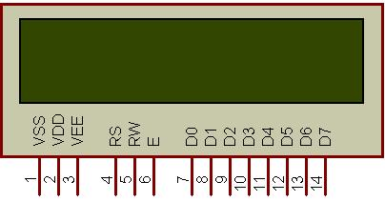
LIQUID CRYSTAL DISPLAY
A liquid crystal display (LCD) is a thin, flat electronic visual display that uses the light modulating properties of liquid crystals.
Liquid crystal display is very important device in embedded system. It offers high flexibility to user as he can display the required data on it.
These are used in a wide range of applications, including computer monitors, television, instrument panels, aircraft, cockpit displays, signage, etc

Slide 14
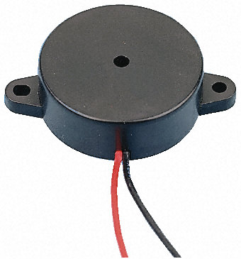
BUZZER
A buzzer or beeper is a signaling device, usually electronic, typically used in automobiles, house hold appliances such as a microwave oven, or game shows.

Slide 15
ENERGY METER
An electricity meter or energy meter is a device that measures the amount of electric energy consumed by a residence, business, or an electrically powered device. Its reading is highly accurate and electronic measurement is more robust than that of the conventional mechanical meters.
Electronic Energy Meter is a substitute for the mechanical energy meter in use currently for monitoring the consumption of electrical energy. The product is targeted at the Electricity Boards and mass consumers.

Slide 16
Features
Accurate energy measurement even in case of phase reversal and/or the load is earthed.
Reverse current & earth load tampering protection.
True R.M.S. meter to ensure good performance even for distorted waveforms.
Sealed electromagnetic impulse counter for additional security.
Accurate reading even at rapidly fluctuating load current.
No effect of high voltage fluctuations.
Resistant to heat, fire and dust.

Slide 17
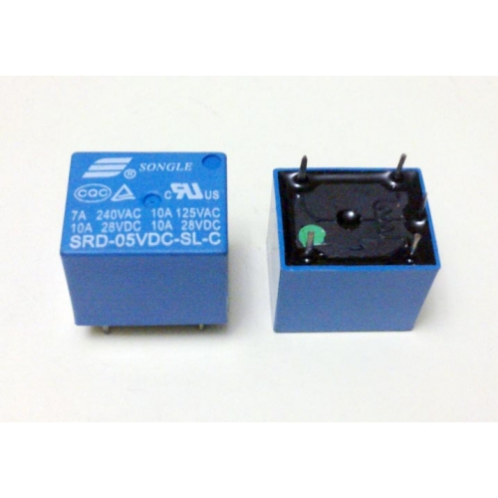
RELAY
A relay is an electromechanical switch, which perform ON and OFF operations without any human interaction. General representation of double contact relay is shown in fig. Relays are used where it is necessary to control a circuit by a low-power signal (with complete electrical isolation between control and controlled circuits), or where several circuits must be controlled by one signal.

Slide 18
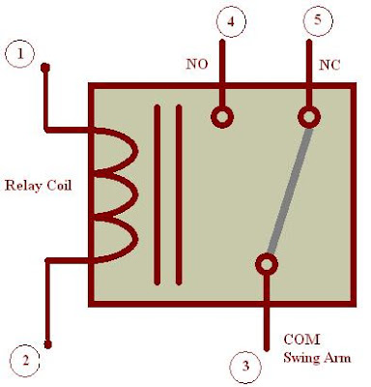
Generally, the relay consists a inductor coil, a spring (not shown in the figure), Swing terminal, and two high power contacts named as normally closed (NC) and normally opened (NO). Relay uses an Electromagnet to move swing terminal between two contacts (NO and NC). When there is no power applied to the inductor coil (Relay is OFF), the spring holds the swing terminal is attached to NC contact.

Slide 19
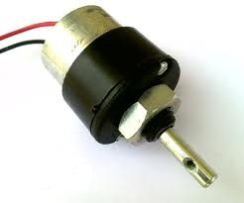
MOTOR
A DC motor in simple words is a device that converts direct current(electrical energy) into mechanical energy. It’s of vital importance for the industry today.

Slide 20
Advantages of the project
High sensitivity
Fast response
Automatic operation
Stable performance and long life
Simple drive circuit
Efficient vehicle control when sensors detect
Efficient and low cost design.
Low power consumption.
Easily operable.

Slide 21
APPLICATION
IOT Based solar and wind power monitoring system.
Ac and DC Appliances control system.

Slide 22
CONCLUSION
The complete working model of a smart energy meter was built which uses existing WIFI Module system. The model satisfactorily worked with a Bulb. Automatic meter reading can be explained well using this system. Financial losses of electricity board can be minimized.
Labour charges and effort can be reduced. The error, time delay that occurs due to manual metering can be avoided to a great extent. Electrical line fault detection has been made easy for the electricity board. Finally but not the least this type of meter supports remote metering which is the future of energy meters.
Unique Id for Admin and User.
Only Admin can modify any data and add new users.
Power used by the users can be monitored hour/daily manner.

Slide 23
REFERENCES
ChristianBeckel and SilviaSantini, “Improving device level electricity consumption breakdowns in private households using ON/OFF events,” ACM SIGBED Rev., vol. 9, pp. 32–38, 2012.
Garrab, A.; Bouallegue, A.; Ben Abdallah, “A new AMR approach for energy saving in Smart Grids using Smart Meter and partial Power Line Communication”, IEEE First International Conference on Renewable Energies and Vehicular Technology (REVET), pp. 263 –269, march 2012
Marco Casini , “Internet of things for Energy efficiency of buildings,” International Scientific Journal Architecture and Engineering. – 2013

Slide 24
THANK YOU!

